Slide 1
MA-PIP
Patient Safety
&
Model for Improvement
Check List
June 10, 2016
Judy Ling

Slide 2
Content
Patient Safety slides 3 - 4
Model for Improvement slide 5
PI Check List slides 6 – 10
Appendix

Slide 3
Science of Patient Safety
Systems thinking
  Most problems do not result from individual workers; but from the design of work processes/system
Safety culture
  Leadership & values
  Teamwork & communication
  Trust, psychological safety
What if you started your staff meetings with the question: “Do you have any patient safety concerns we should talk about?”
Notes:
We don’t blame the people, we improve the system in which they work
Every system is perfectly designed to get the results it gets; if we want to improve results we need to improve system
Insanity is doing the same thing over and over and expecting different results
Safety culture starts from the top, as defined by leadership beliefs and core values
What if you started your staff meetings with the question: “Do you have a patient safety concern we can talk about?”
Requires teamwork and communication
And atmosphere of trust, where individuals feel safe to share information about unsafe or potentially hazardous conditions so that we can identify strategies for improvement

Slide 4
Strategies for Patient Safety
Goal: Nothing in the process of care (or omitted during care) contributes to harm to the patient
  “Safety Eyes” - looking at daily work for safety problems
  Starting meetings/huddles with a question about safety concerns –
    “What keeps you up at night?”
    “What have you seen that you worry could harm a patient?”
  Asking patients for their ideas/worries
  Keeping a “Glitch List” - processes that need improvement
  Using the Model for improvement and Plan-Do-Study-Act cycles for continuous improvement
Test: Have we improved the process so the patient is safe yet?

Slide 5
Science of Patient Safety
Systems thinking
  Most problems do not result from individual workers; but from the design of work processes/system
Safety culture
  Leadership & values
  Teamwork & communication
  Trust, psychological safety
What if you started your staff meetings with the question: “Do you have any patient safety concerns we should talk about?”
Notes:
We don’t blame the people, we improve the system in which they work
Every system is perfectly designed to get the results it gets; if we want to improve results we need to improve system
Insanity is doing the same thing over and over and expecting different results
Safety culture starts from the top, as defined by leadership beliefs and core values
What if you started your staff meetings with the question: “Do you have a patient safety concern we can talk about?”
Requires teamwork and communication
And atmosphere of trust, where individuals feel safe to share information about unsafe or potentially hazardous conditions so that we can identify strategies for improvement

Slide 6
Strategies for Patient Safety
Goal: Nothing in the process of care (or omitted during care) contributes to harm to the patient
  “Safety Eyes” - looking at daily work for safety problems
  Starting meetings/huddles with a question about safety concerns –
    “What keeps you up at night?”
    “What have you seen that you worry could harm a patient?”
  Asking patients for their ideas/worries
  Keeping a “Glitch List” - processes that need improvement
  Using the Model for improvement and Plan-Do-Study-Act cycles for continuous improvement
Test: Have we improved the process so the patient is safe yet?

Slide 7

Using the MFI Framework
Answer what are we improving, how much, by when.
To increase/decrease XXX by ZZ% by YY date.
Sample measurement
Number of XXX (numerator)
Total number of XXX (denominator)
Team to provide test ideas.
PDSA =
The PDSA form can be used when you get here
Developed by: Associates in Process Improvement
Notes:
Need to know baseline before you can increase or decrease by xx%

Slide 8
Process Improvement Check List
Getting Started
Select a Patient Safety topic to solve
Ask- What keeps you up at night?
Getting Started
Don’t boil the ocean
Ask – Can we narrow the scope? Not all referrals, not all test follow-up, not all patients.
Getting Started
Assemble a Team
Ask – Who are the front-line staff?
Ask – How can we get patient feedback?
Hint – Keep a list on a “parking lot”. Use a “glitch book” to keep track of ideas.
Notes:
Example – delayed and missing results at Marino frustrates everyone and creates patient dissatisfaction. The risk of missing something critical is high for many of the labs. Specialty reference tests are the worst but all labs are impacted.
Input from all levels of staff indicated that staff at every level as well as providers and patients spent time following up on specialty labs and would benefit from an improved process. We had an inconsistent process but patient education and following up on delays were identified as the two biggest opportunities.
To keep the project simple and manageable we agreed that patient education was the biggest opportunity for improvement. The biggest barrier was delays in testing due to misinterpretation of test requirements. We decided to focus on that and standardize tracking as part of the process.
Once this was decided the AIM statement followed. We will close the loop on 90% of our specialty lab tests within 30 business days.

Slide 9
Process Improvement Check List
Getting Started
Get some baseline data
Ask – What is happening now?
Getting started
Write an Aim Statement
Ask – Now that we have a baseline, what do we measure so we know how much to improve by when?
Clarify Refine
Narrow the focus of the Aim Statement
Ask – Can we narrow the scope? Not all referrals, not all test follow-up, not all patients
Hint – When you have a good Aim Statement, you know what to measure.
Hint – Don’t get stuck here. Just enough data, one day’s; one week’s. Extrapolate from there.
Notes:
Example – delayed and missing results at Marino frustrates everyone and creates patient dissatisfaction. The risk of missing something critical is high for many of the labs. Specialty reference tests are the worst but all labs are impacted.
Input from all levels of staff indicated that staff at every level as well as providers and patients spent time following up on specialty labs and would benefit from an improved process. We had an inconsistent process but patient education and following up on delays were identified as the two biggest opportunities.
To keep the project simple and manageable we agreed that patient education was the biggest opportunity for improvement. The biggest barrier was delays in testing due to misinterpretation of test requirements. We decided to focus on that and standardize tracking as part of the process.
Once this was decided the AIM statement followed. We will close the loop on 90% of our specialty lab tests within 30 business days.

Slide 10
Process Improvement Check List
Clarify Refine
Ask – What are the 3-5 Primary Drivers to achieve our Aim? What are the 2-3 Secondary Drivers that create each Primary Driver?
Clarify Refine
Flow Chart
Ask – What are the 5 – 7 steps?
Clarify Refine
Test Ideas
Ask – What can we try by next Tuesday? Can it be tested with 1 provider/ 1 patient? Tested with 1 referral etc.?
Hint – Frontline staff have the best Test Ideas.
Hint – Don’t go over 5 Primary Drivers. It’ll just get too complicated. This is an iterative process. You may modify the Driver Diagram over time.
Hint – Last step is always Patient receives appropriate follow-up.
Driver Diagram
Notes:
Example – delayed and missing results at Marino frustrates everyone and creates patient dissatisfaction. The risk of missing something critical is high for many of the labs. Specialty reference tests are the worst but all labs are impacted.
Input from all levels of staff indicated that staff at every level as well as providers and patients spent time following up on specialty labs and would benefit from an improved process. We had an inconsistent process but patient education and following up on delays were identified as the two biggest opportunities.
To keep the project simple and manageable we agreed that patient education was the biggest opportunity for improvement. The biggest barrier was delays in testing due to misinterpretation of test requirements. We decided to focus on that and standardize tracking as part of the process.
Once this was decided the AIM statement followed. We will close the loop on 90% of our specialty lab tests within 30 business days.

Slide 11
Process Improvement Check List
PDSA
Hint – The hypothesis asks if we do X will Y happen?
PDSA
Use the PDSA form as a check list
Ask – Who is doing what when? Who is collecting the data?
PDSA
Test versus Task
Test – Provides an answer to the hypothesis.
Task – Doing something that makes the Test possible; write a letter, get feedback from a patient etc.
Hint – Don’t collect a lot of data.
Hypothesis
Hint – Test small. Fail Fast, Fail Often!
Ask – What is your prediction?
Notes:
Example – delayed and missing results at Marino frustrates everyone and creates patient dissatisfaction. The risk of missing something critical is high for many of the labs. Specialty reference tests are the worst but all labs are impacted.
Input from all levels of staff indicated that staff at every level as well as providers and patients spent time following up on specialty labs and would benefit from an improved process. We had an inconsistent process but patient education and following up on delays were identified as the two biggest opportunities.
To keep the project simple and manageable we agreed that patient education was the biggest opportunity for improvement. The biggest barrier was delays in testing due to misinterpretation of test requirements. We decided to focus on that and standardize tracking as part of the process.
Once this was decided the AIM statement followed. We will close the loop on 90% of our specialty lab tests within 30 business days.

Slide 12
Process Improvement Check List
PDSA
Sustain
Run Charts
Display run chart in break room. Start staff meetings with Pt Safety question.
Spread
Share your stories
Other practices could learn from your journey. Share your successes, failures and surprises.
Adopt, Adapt, Abandon
Ask – Is this a system change or are we relying on people’s good intentions?
Hint – Patient stories are powerful!
Ask – Did we achieve the outcome we wanted?
Ask – If not, can we tweak the change? Test something else? Does this process work on weekends or when X is out? Is there a back-up plan?
Ask – What else can we solve? Go look at the “parking lot” for ideas!
Celebrate!
Notes:
Example – delayed and missing results at Marino frustrates everyone and creates patient dissatisfaction. The risk of missing something critical is high for many of the labs. Specialty reference tests are the worst but all labs are impacted.
Input from all levels of staff indicated that staff at every level as well as providers and patients spent time following up on specialty labs and would benefit from an improved process. We had an inconsistent process but patient education and following up on delays were identified as the two biggest opportunities.
To keep the project simple and manageable we agreed that patient education was the biggest opportunity for improvement. The biggest barrier was delays in testing due to misinterpretation of test requirements. We decided to focus on that and standardize tracking as part of the process.
Once this was decided the AIM statement followed. We will close the loop on 90% of our specialty lab tests within 30 business days.

Slide 13
Appendix

Slide 14
The three MFI Questions
MFI questions | Sample answers
1. What are we trying to accomplish? | Aim Statement – Our current rate of closing the loop with FOBTs is 33% within 15 business days. Our Aim is to close 90% within 15 business days by 6/30/xxxx.
2. How will we know that a change is an improvement? | Measurement Number of FOBTs returned within 15 business days/Number of FOBTs given out (per day)
3. What changes can we make that will result in an improvement? | Team to provide test ideas.
Notes:
“Some is not a number.”
“Soon is not a time.”
“Hope is not a plan.”

Slide 15
Example of PI Project selection
Let’s fix the referral process
Let’s fix the GI referral process
Let’s fix the colonoscopy referral process
Let’s fix the routine colonoscopy referral process
Let’s fix the routine colonoscopy referral process between 1 PCP and 1 GI doc

Slide 16
Sample Driver Diagram
Primary Drivers
Secondary Drivers
Correct diagnosis codes in EMR
Aim Statement
Correct identification of Diabetic Patients
Ran correct pt reports
Increase Diabetic Eye exams from baseline of 30% to 75% by 12/31/2016
Pt has correct info to make apptmt
Patients complete Diabetic Eye Exams
Pt understands importance of eye exam
Practice receives results
Specialist has correct practice contact info

Slide 17
Blank Driver Diagram
Secondary Drivers
Primary Driver
Secondary Drivers
Aim Statement
Secondary Drivers
Primary Driver
Secondary Drivers
Primary Driver
Secondary Drivers
PRIMARY – Key contributors to desired outcome. Examples: Could be a concrete process step such as “Correct identification of Diabetic Patients”; could be a underlying condition in the practice/general concept such as “Leadership” or “ Patient Engagement” No more than 5.
SECONDARY – Factors that influence Primary Drivers. 1 to 3 Secondary Drivers per Primary Driver.
IHI Video on how to use Driver Diagrams
https://www.youtube.com/watch?v=yfcE_Q-IRFg&feature=youtu.be

Slide 18
High Level Flow Chart
What are the logical 4 – 7 steps?
Which step would include patient input?
Was the last step making sure the patient had the correct follow-up?
i.e. Diagnose Order test or referral
Patient receives follow-up
Some action that starts the process.
Can start with a verb.

Slide 19
Measurement
You know you have a clear Aim Statement when it is easy to identify what to measure.
  Increase Diabetic Eye exams from baseline of 30% to 75% by 12/31/2016.
Rapid small tests to check if idea works or not. Fail often, Fail fast.
A fun TED Talk on celebrating failure: https://www.ted.com/talks/astro_teller_the_unexpected_benefit_of_celebrating_failure
This is where you
get your denominator
Use this to figure out what would be the numerator

Slide 20
Test Ideas
A good test idea answers a hypothesis.
  Hypothesis – if we send a patient letter explaining why a diabetic eye exam is so important, an educated patient would be more likely to complete the eye exam.
    Test – Send letter to diabetic patient population with clearly stated reasons why eye exams are necessary, and give names/locations/times of eye exam providers.
      Task – Write draft letter.
      Task – show draft letter to select patients to get feed-back.
Allows you to answer y/n to hypothesis
Makes the test possible

Slide 21
Two Process Improvement Tools
Patient Question Tool: On a scale of 1 to 10, 10 being the most likely, ask -
  How important do you think it is to complete XYZ?
  How likely are you going to complete the appointment/test?
  What would make it a 10?
Teach back: ask the patient –
  “We went through quite a bit of information today. Just so I know I was clear, can you tell me how you will do this test when you get home?”
Open-ended questions

Slide 22
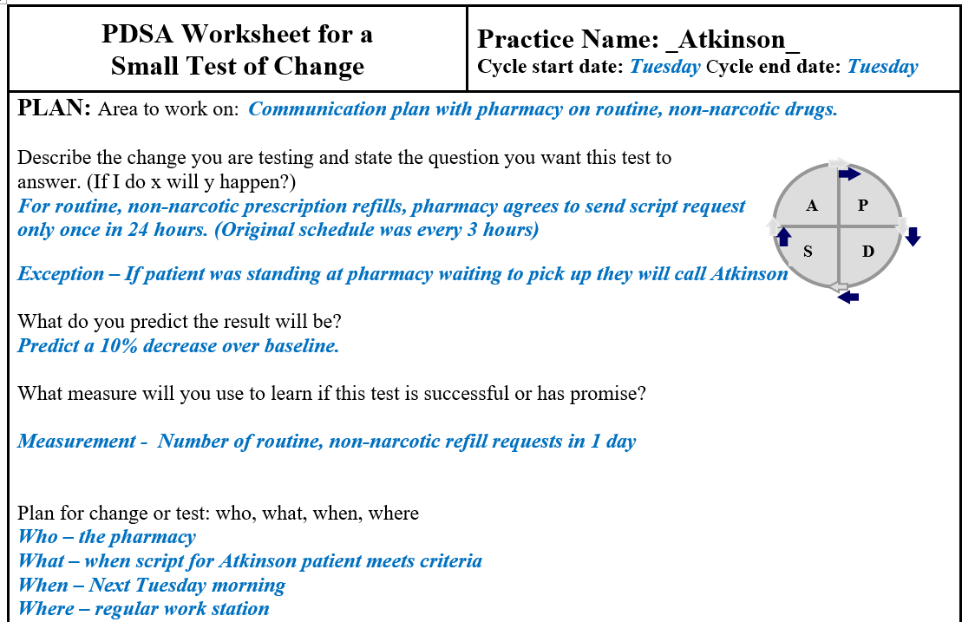
Sample PDSA Form - 1

Slide 23
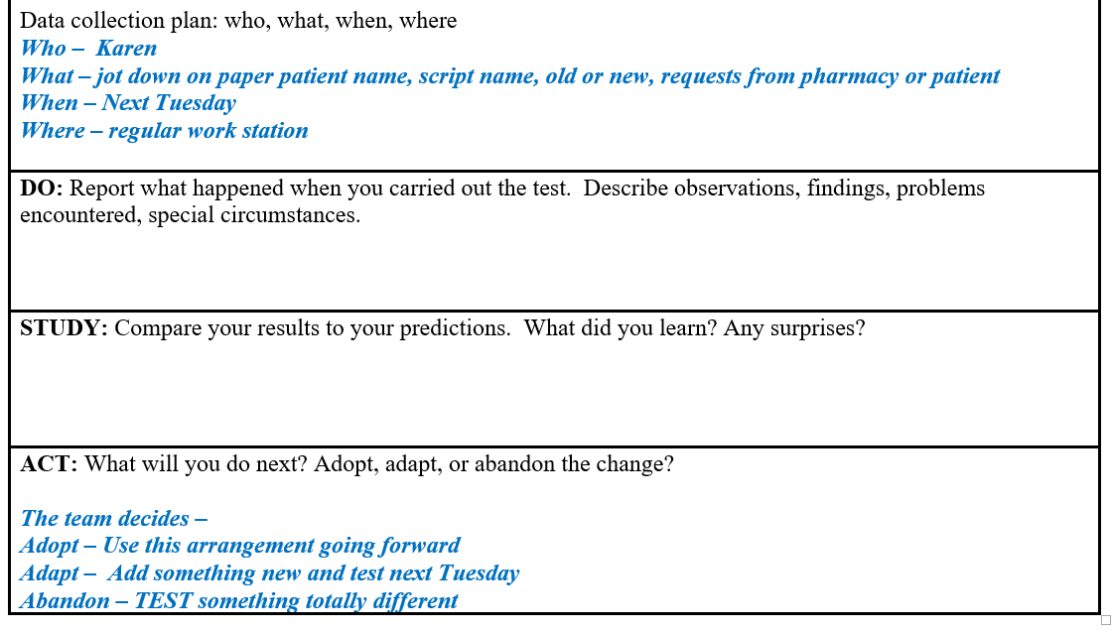
Sample PDSA Form - 2

Slide 24
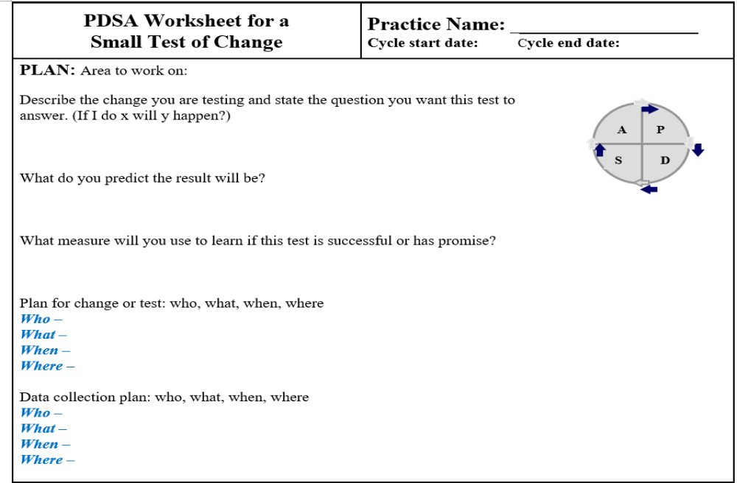
Blank PDSA Form

Slide 25
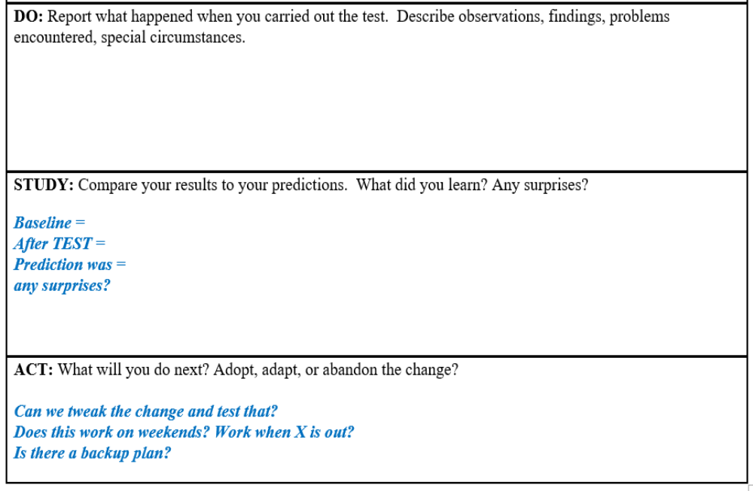
Blank PDSA Form

Slide 26
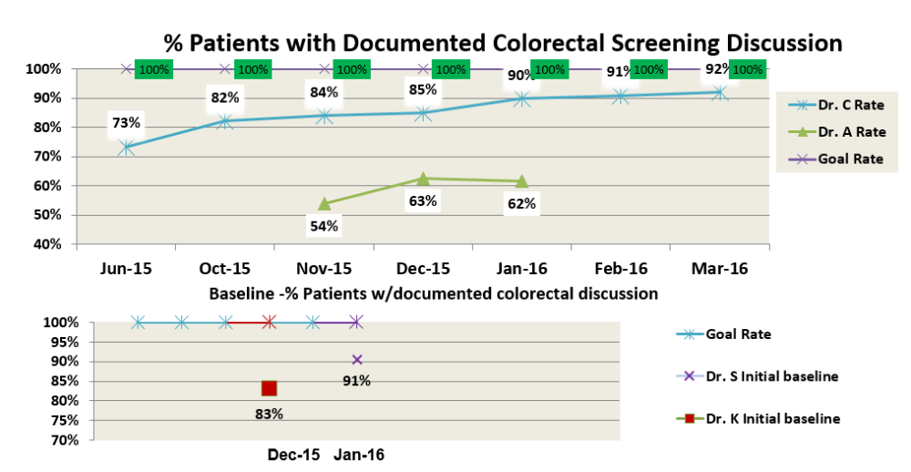
Sample Run Chart

Slide 27
Hierarchy of Sustaining Change
Weakest
Policies,
training,
inspection
ASK: does the change depend on well meaning person or well designed system?
Minimize
consequences of errors
Make errors visible
Make it easy to do the right thing
Make it hard to do the wrong thing
Eliminate opportunity for error
Strongest
Standardization & Simplification
Doug Bonacum, Kaiser Permanente

Slide 28
TED Talks and other Videos
The importance of listening well -
  https://www.ted.com/talks/ernesto_sirolli_want_to_help_someone_shut_up_and_listen
Making Toast! Or how to do flow charts –
  https://www.ted.com/talks/tom_wujec_got_a_wicked_problem_first_tell_me_how_you_make_toast#t-37362
Celebrating failure –
  https://www.ted.com/talks/astro_teller_the_unexpected_benefit_of_celebrating_failure
IHI Video on Driver Diagrams –
  https://www.youtube.com/watch?v=yfcE_Q-IRFg

